Slide 1
Editor Scripting in Unity
Porrith Suong

Slide 2
What is Editor Scripting?
Editor scripting extends functionality in Unity’s default inspector
We can build designer/Unity friendly tools to enhance our development experience
Less [code] to look at for a non technical teammate or person

Slide 3
Editor Scripting Basics
Decorators
Decorators overlap base functionality and provides modularity and extensions
Hence they “decorate” functionality and make things easier
Unity provides a few Decorators which are really helpful:
[Header]
[Range(float min, float max)]
[Tooltip(string help)]
[TextArea]

Slide 4
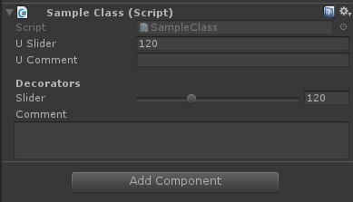
Editor Scripting Basics
But let’s be fair, that’s pretty basic
We’re not necessarily doing Editor Scripting, just using decorators to enhance our Editor…

Slide 5
Is Editor Scripting Necessary?
No real, answer – it depends on your project
For short term projects – probably not
Long terms projects – yes!
The mindset for Editor scripting is different than game development
“How can I supplement my game using tools that is generic?” - TOOLS DEVELOPMENT
VS
“What feature should I implement into my game?” – GAME DEVELOPMENT

Slide 6
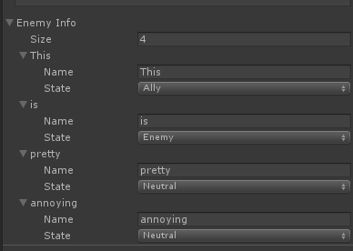
When Editor Scripting is Useful
Imagine an array of structs/classes
Structs/classes can have multiple fields inside them
An array of those can be nightmarish to implement
Seriously who wants to keep clicking and manipulating the drop down and the string like below!?

Slide 7
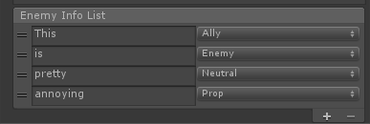
When Editor Scripting is Useful
Imagine an array of structs/classes
Structs/classes can have multiple fields inside them
An array of those can be nightmarish to implement
Seriously who wants to keep clicking and manipulating the drop down and the string like below!?

Slide 8
Is there an API for it?
Short answer, YES
Long answer: Unity provides no documentation for some of the stuff we’re doing. A few things we will do have documentation
See the Editor class in Unity’s API

Slide 9
How do you compensate for no API?
Your IDE (internal development environment) is extremely useful in deconstructing undocumented code
Scour the internet, most answers are found on Unity Answers or StackOverflow

Slide 10
Editor Scripting Outline
Your class must derive from the Editor class, not MonoBehaviour
Use OnEnable() and OnDisable() as your constructor and destructor
Always use UnityEditor namespace
UnityEditorInternal namespace is optional (this is undocumented)

Slide 11
Editor Scripting Outline Cont.
To override the Inspector – override OnInspectorGUI()
To override the SceneView Editor – override OnSceneGUI(SceneView sceneView)

Slide 12
Template for Inspector Editor Scripting
using UnityEditor;
using UnityEditorInternal;
using UnityEngine;
public class EditorSample : Editor {
private SerializeProperty property; // Reference to the Serialized Property
private ReordableList propertyList; // Internal list
private void OnEnable() {
// Use for initialization
}
private void OnDisable() {
// Use as destructor
}
public override void OnInspectorGUI() {
// Where your main code will go
}
}

Slide 13
Template for SceneView Editor Scripting
using UnityEditor;
using UnityEditorInternal;
using UnityEngine;
public class EditorSample : Editor {
// Add your serializedProperties here
private void OnEnable() {
// Use for initialization
}
private void OnDisable() {
// Use as destructor
}
public override void OnSceneGUI(SceneView sceneView) {
// Where your main code will go
}
}

Slide 14
Delegates
These are functions – which may contain functionality of many different functions
If you’re used to C++ then they are similar to function pointers
void *some_cpp_function();
Otherwise, imagine a container with the same type of functions and parameters:
[ void function_1(int), void function_2(int), void function_3(int) ]
We can invoke all of them without directly calling them!
Useful for event based programming – which is essential editor scripting
A function can be added to a delegate using the += operator
A function can be removed from a delegate using the -= operator

Slide 15
Lambdas
Lambdas are anonymous functions – functions without an explicit function definition
Example:
EXPLICIT: int add(int a, int b) { return a + b; }
IMPLICIT: (int a, int b) => { return a + b };
The two statements are equivalently the same
Lambdas are short hands for writing functionalities into delegates, but fundamentally they are functions

Slide 16
Recap
Editor scripting is about finding the properties we need to manipulate and show
The ReordableList class is not within the documentations, but most other things are in the API
Editor Scripting requires some hard coding, you can make it generic – but it requires some degree of engineering to make it entirely flexible

Slide 17
Contact
https://github.com/psuong/editor-scripting-class
Email: psuong95@gmail.com

